Slide 1
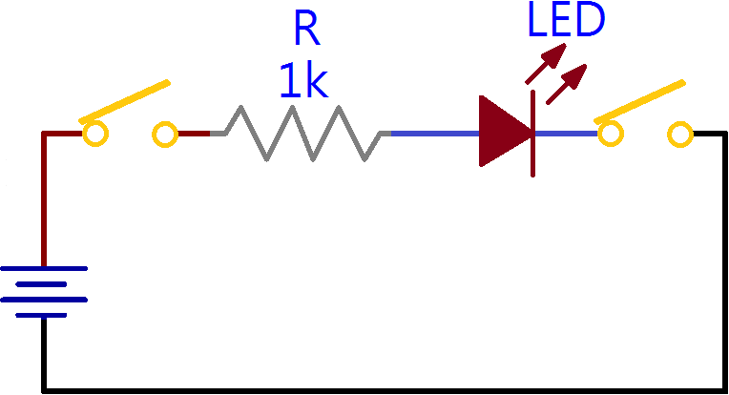
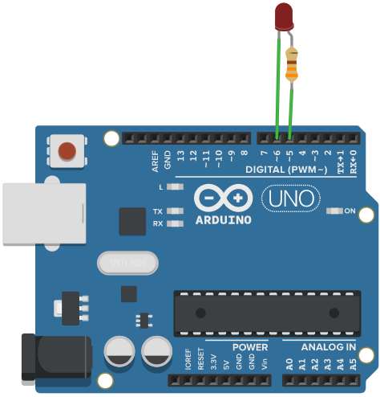
ARDUINO 範例演練
兩極控制模式
5
6
void setup() { pinMode(5, OUTPUT); pinMode(6, OUTPUT); digitalWrite(5, 1); digitalWrite(6, 1); } void loop() { digitalWrite(6, 0); delay(1000); digitalWrite(6, 1); delay(1000); }

Slide 2
ARDUINO 範例演練
兩極控制模式
5
6
void setup() { pinMode(5, OUTPUT); pinMode(6, OUTPUT); digitalWrite(5, 1); digitalWrite(6, 1); } void loop() { digitalWrite(6, 0); delay(1000); digitalWrite(6, 1); delay(1000); }

Slide 3
ARDUINO 範例演練
兩極控制模式
5
6
void setup() { pinMode(5, OUTPUT); pinMode(6, OUTPUT); digitalWrite(5, 1); digitalWrite(6, 1); } void loop() { digitalWrite(6, 0); delay(1000); digitalWrite(6, 1); delay(1000); }

Slide 4
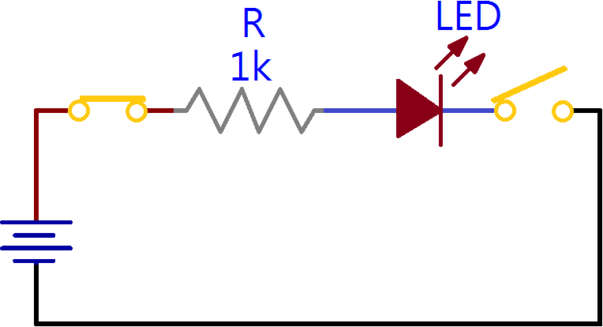
ARDUINO 範例演練
兩極控制模式
5
6
void setup() { pinMode(5, OUTPUT); pinMode(6, OUTPUT); digitalWrite(5, 1); digitalWrite(6, 1); } void loop() { digitalWrite(6, 0); delay(1000); digitalWrite(6, 1); delay(1000); }

Slide 5
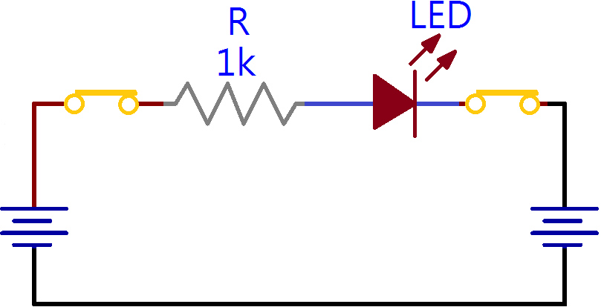
ARDUINO 範例演練
兩極控制模式
5
6
void setup() { pinMode(5, OUTPUT); pinMode(6, OUTPUT); digitalWrite(5, 1); digitalWrite(6, 1); } void loop() { digitalWrite(6, 0); delay(1000); digitalWrite(6, 1); delay(1000); }

Slide 6
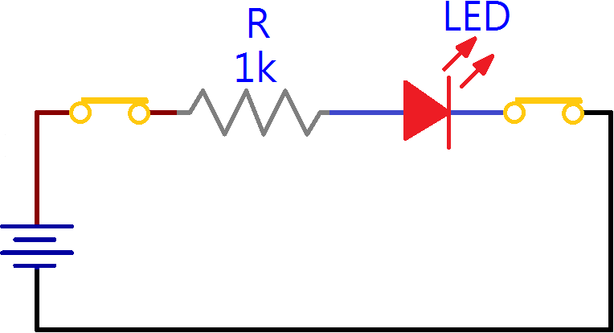
ARDUINO 範例演練
兩極控制模式
5
6
void setup() { pinMode(5, OUTPUT); pinMode(6, OUTPUT); digitalWrite(5, 1); digitalWrite(6, 1); } void loop() { digitalWrite(6, 0); delay(1000); digitalWrite(6, 1); delay(1000); }

Slide 7
ARDUINO 範例演練
兩極控制模式
5
6
void setup() { pinMode(5, OUTPUT); pinMode(6, OUTPUT); digitalWrite(5, 1); digitalWrite(6, 1); } void loop() { digitalWrite(6, 0); delay(1000); digitalWrite(6, 1); delay(1000); }

Slide 8
ARDUINO 範例演練
兩極控制模式
5
6
void setup() { pinMode(5, OUTPUT); pinMode(6, OUTPUT); digitalWrite(5, 1); digitalWrite(6, 1); } void loop() { digitalWrite(6, 0); delay(1000); digitalWrite(6, 1); delay(1000); }

Slide 9
ARDUINO 範例演練
兩極控制模式
5
6
void setup() { pinMode(5, OUTPUT); pinMode(6, OUTPUT); digitalWrite(5, 1); digitalWrite(6, 1); } void loop() { digitalWrite(6, 0); delay(1000); digitalWrite(6, 1); delay(1000); }

Slide 10
ARDUINO 範例演練
兩極控制模式
5
6
void setup() { pinMode(5, OUTPUT); pinMode(6, OUTPUT); digitalWrite(5, 1); digitalWrite(6, 1); } void loop() { digitalWrite(6, 0); delay(1000); digitalWrite(6, 1); delay(1000); }

Slide 11
ARDUINO 範例演練
兩極控制模式
5
6
void setup() { pinMode(5, OUTPUT); pinMode(6, OUTPUT); digitalWrite(5, 1); digitalWrite(6, 1); } void loop() { digitalWrite(6, 0); delay(1000); digitalWrite(6, 1); delay(1000); }

Slide 12
ARDUINO 範例演練
兩極控制模式
5
6
void setup() { pinMode(5, OUTPUT); pinMode(6, OUTPUT); digitalWrite(5, 1); digitalWrite(6, 1); } void loop() { digitalWrite(6, 0); delay(1000); digitalWrite(6, 1); delay(1000); }

Slide 13
ARDUINO 範例演練
兩極控制模式
5
6
void setup() { pinMode(5, OUTPUT); pinMode(6, OUTPUT); digitalWrite(5, 1); digitalWrite(6, 1); } void loop() { digitalWrite(6, 0); delay(1000); digitalWrite(6, 1); delay(1000); }

